Slide 1
UNIT 5 SE&OOAD

Slide 2
Software project management:
It is an art and discipline of planning and supervising software projects.
It is a sub-discipline of software project management in which software projects planned, implemented, monitored and controlled.
It is a procedure of managing, allocating and timing resources to develop computer software that fulfills requirements.
In software Project Management, the client and the developers need to know the length, period and cost of the project.

Slide 3
Needs Software project management:
There are three needs for software project management. These are:
Time
Cost
Quality
It is an essential part of the software organization to deliver a quality product, keeping the cost within the client?s budget and deliver the project as per schedule.
There are various factors, both external and internal, which may impact this triple factor.

Slide 4
Project Manager:
A project manager is a character who has the overall responsibility for the planning, design, execution, monitoring, controlling and closure of a project.
A project manager represents an essential role in the achievement of the projects.
A project manager is a character who is responsible for giving decisions, both large and small projects.
The project manager is used to manage the risk and minimize uncertainty. Every decision the project manager makes must directly profit their project.

Slide 5
Role of a Project Manager:
1. Leader: A project manager must lead his team and should provide them direction to make them understand what is expected from all of them.
2.Medium: The Project manager is a medium between his clients and his team.
He must coordinate and transfer all the appropriate information from the clients to his team and report to the senior management.
3. Mentor: He should be there to guide his team at each step and make sure that the team has an attachment.
He provides a recommendation to his team and points them in the right direction.

Slide 6
Responsibilities of a Project Manager:
Managing risks and issues.
Create the project team and assigns tasks to several team members.
Activity planning and sequencing.
Monitoring and reporting progress.
Modifies the project plan to deal with the situation.

Slide 7
Software Configuration Management:
When we develop software, the product (software) undergoes many changes in their maintenance phase; we need to handle these changes effectively.
Several individuals (programs) works together to achieve these common goals.
This individual produces several work product (SC Items) e.g., Intermediate version of modules or test data used during debugging, parts of the final product.
The elements that comprise all information produced as a part of the software process are collectively called a software configuration.
As software development progresses, the number of Software Configuration elements (SCI's) grow rapidly.

Slide 8
A configuration of the product refers not only to the product's constituent but also to a particular version of the component.
Therefore, SCM is the discipline which
Identify change
Monitor and control change
Ensure the proper implementation of change made to the item.
Auditing and reporting on the change made.
Configuration Management (CM) is a technic of identifying, organizing, and controlling modification to software being built by a programming team.

Slide 9
CM is used to essential due to the inventory management, library management, and updation management of the items essential for the project.
Why do we need Configuration Management?
Multiple people are working on software which is consistently updating.
It may be a method where multiple version, branches, authors are involved in a software project, and the team is geographically distributed and works concurrently.
It changes in user requirements, and policy, budget, schedules need to be accommodated.

Slide 10
Importance of SCM:
It is practical in controlling and managing the access to various SCIs e.g., by preventing the two members of a team for checking out the same component for modification at the same time.
it provides the tool to ensure that changes are being properly implemented.
It has the capability of describing and storing the various constituent of software.
SCM is used in keeping a system in a consistent state by automatically producing derived version upon modification of the same component.

Slide 11
PROJECT PLANNING ACTIVITIES LIST:
The activity planning stage is very important for any type of project.
Let’s take a look at a project planning activities list for activity planning and sequencing:
Determine project requirements
Identify all database
Determine cost estimates
Revise the risk assessment
Define and identify critical success factors
Write up the project charter
Create a detailed project plan
Begin the project

Slide 12
Activity planning in project management and process plans that offer detailed outlines of work instructions will greatly help project teams and stimulate productive and effective work.
Process activity planning offers important step-by-step instructions that are crucial to understand in order to team members to perform activities properly and to a higher level of quality.
Sinnaps:critical path of your project that calculates the most optimal workflow and highlights task dependencies as well as the activities most crucial to successful project completion.
This can be used for software planning activities and generic project planning activities.

Slide 13
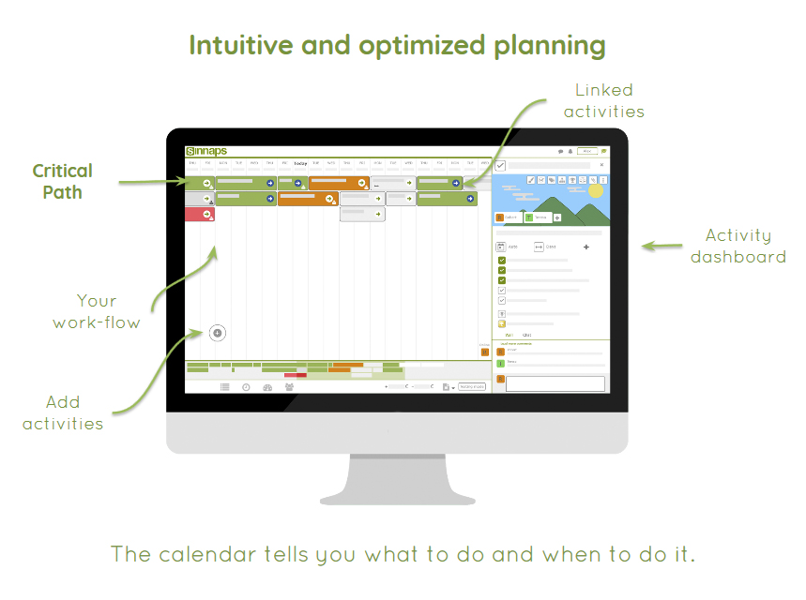

Slide 14
Activity planning and sequencing can be carefully monitored and controlled with activity planning in software project management tools such as the Kanban board that is linked with your Gantt flow and shows real-time project progress and status.
Planning and activities done during the project can be validated easily by project team members assigned to the tasks.
Each activity includes detailed information to help team members understand what is required and planning activities across a timeline lets them know when completion is due.

Slide 15
Software Measurement and Metrics:
Software Measurement: A measurement is a manifestation of the size, quantity, amount, or dimension of a particular attribute of a product or process.
Software measurement is a titrate impute of a characteristic of a software product or the software process.
It is an authority within software engineering. The software measurement process is defined and governed by ISO Standard.

Slide 16
Software Measurement Principles:
The software measurement process can be characterized by five activities-
Formulation: The derivation of software measures and metrics appropriate for the representation of the software that is being considered.
Collection: The mechanism used to accumulate data required to derive the formulated metrics.
Analysis: The computation of metrics and the application of mathematical tools.
Interpretation: The evaluation of metrics resulting in insight into the quality of the representation.
Feedback: Recommendation derived from the interpretation of product metrics transmitted to the software team.

Slide 17
Need for Software Measurement:
Software is measured to:
Create the quality of the current product or process.
Anticipate future qualities of the product or process.
Enhance the quality of a product or process.
Regulate the state of the project in relation to budget and schedule

Slide 18
Classification of Software Measurement:
There are 2 types of software measurement:
1)Direct Measurement: In direct measurement, the product, process, or thing is measured directly using a standard scale.
2)Indirect Measurement: In indirect measurement, the quantity or quality to be measured is measured using related parameters i.e. by use of reference.

Slide 19
Metrics:
A metric is a measurement of the level at which any impute belongs to a system product or process.
Software metrics will be useful only if they are characterized effectively and validated so that their worth is proven.
There are 4 functions related to software metrics:
Planning
Organizing
Controlling
Improving

Slide 20
Characteristics of software Metrics:
Quantitative: Metrics must possess quantitative nature. It means metrics can be expressed in values.
Understandable: Metric computation should be easily understood, and the method of computing metrics should be clearly defined.
Applicability: Metrics should be applicable in the initial phases of the development of the software.
Repeatable: The metric values should be the same when measured repeatedly and consistent in nature.
Economical: The computation of metrics should be economical.
Language Independent: Metrics should not depend on any programming language.

Slide 21
Classification of Software Metrics:
There are 3 types of software metrics:
Product Metrics: Product metrics are used to evaluate the state of the product, tracing risks and undercover prospective problem areas. The ability of the team to control quality is evaluated.
Process Metrics: Process metrics pay particular attention to enhancing the long-term process of the team or organization.
Project Metrics: The project matrix describes the project characteristic and execution process. Like....
Number of software developer
Staffing patterns over the life cycle of software
Cost and schedule
Productivity

Slide 22
Advantages of Software Metrics :
Reduction in cost or budget.
It helps to identify the particular area for improvising.
It helps to increase the product quality.
Managing the workloads and teams.
Reduction in overall time to produce the product,.
It helps to determine the complexity of the code and to test the code with resources.
It helps in providing effective planning, controlling and managing of the entire product.

Slide 23
Disadvantages of Software Metrics :
It is expensive and difficult to implement the metrics in some cases.
Performance of the entire team or an individual from the team can’t be determined.
Only the performance of the product is determined.
Sometimes the quality of the product is not met with the expectation.
It leads to measure the unwanted data which is wastage of time.
Measuring the incorrect data leads to make wrong decision making.

Slide 24
PROJECT SIZE ESTIMATION :
Estimation is the process of finding an estimate, or approximation, which is a value that can be used for some purpose even if input data may be incomplete, uncertain, or unstable.
Estimation determines how much money, effort, resources, and time it will take to build a specific system or product. Estimation is based on −
Past Data/Past Experience
Available Documents/Knowledge
Assumptions
Identified Risks

Slide 25
Currently two metrics are popularly being used widely to estimate size:
1- lines of code (LOC)
2- function point (FP)

Slide 26
LINES OF CODE (LOC):
LOC is the simplest among all metrics available to estimate project size.
This metric is very popular because it is the simplest to use.
Using this metric, the project size is estimated by counting the number of source instructions in the developed program.
Obviously, while counting the number of source instructions, lines used for commenting the the code and the header lines should be ignored.
Determining the LOC count at the end of a project is a very simple job.

Slide 27
However, accurate estimation of the LOC count at the beginning of a project is very difficult.
In order to estimate the LOC count at the beginning of a project.
project managers usually divide the problem into modules, and each module into submodules and so on, until the sizes of the different leaf-level modules can be approximately predicted.
To be able to do this, past experience in developing similar products is helpful.
By using the estimation of the lowest level modules, project managers arrive at the total size estimation.

Slide 28
FUNCTION POINT (FP):
Function point metric was proposed by Albrecht [1983].
This metric overcomes many of the shortcomings of the LOC metric.
Since its inception in late 1970s, function point metric has been slowly gaining popularity.
One of the important advantages of using the function point metric is that it can be used to easily estimate the size of a software product directly from the problem specification.
This is in contrast to the LOC metric, where the size can be accurately determined only after the product has fully been developed.
The conceptual idea behind the function point metric is that the size of a software product is directly dependent on the number of different functions or features it supports.

Slide 29
EFFORT ESTIMATON TECHQNIQUES:
Estimation is the process of finding an estimate, or approximation, which is a value that can be used for some purpose even if input data may be incomplete, uncertain, or unstable.
Estimation determines how much money, effort, resources, and time it will take to build a specific system or product.
Estimation is based on −
Past Data/Past Experience
Available Documents/Knowledge
Assumptions
Identified Risks

Slide 30
A realistic effort estimate requires you to have a clear understanding of certain elements of the project:
The purpose and scope of the project (If working with a client, what are their expectations?)
What needs to be done to achieve it
What resources should be allocated
Timeline

Slide 31
The four basic steps in Software Project Estimation are −
Estimate the size of the development product.
Estimate the effort in person-months or person-hours.
Estimate the schedule in calendar months.
Estimate the project cost in agreed currency.
Observations on Estimation:
Estimation need not be a one-time task in a project.
It can take place during −
Acquiring a Project.
Planning the Project.
Execution of the Project as the need arises.

Slide 32
1. Top-down Estimate:
Once more detail is learned on the project's scope, a top-down estimating technique assigns an overall time for the project and divides the project into parts according to the work breakdown structure.
2. Bottom-up Estimate:
The bottom-up method is the opposite of top-down.
It approaches the project as a combination of small workpieces. By making a detailed estimate for each task and combining them together, you can build an overall project estimate.
3. Expert judgement:
The expert judgment technique requires consulting the expert who will perform the task to ask how long it will take to complete.
This method relies on your trust in the expert's insights and experience.

Slide 33
4. Analogous Estimating :
Analogous estimating is a technique for estimating based on similar projects completed in the past.
If the whole project has no analogs, it can be applied by blending it with the bottom-up technique. In this case, you compare the tasks with their counterparts, then combine them to estimate the overall project..
5. Three-point Estimating:
Three-point estimating is very straightforward.
It involves three different estimates that are usually obtained from subject matter experts:
Optimistic estimate
Pessimistic estimate
Most likely estimate

Slide 34
(1)Optimistic estimate:
The optimistic estimate gives the amount of work and time that would be required if everything went smoothly.
(2)pessimistic estimate:
A pessimistic estimate provides the worst-case scenario.
(3)Most likely estimate:
The result will be most realistic when the two are averaged with the most likely estimate.

Slide 35
Conclusion :
Effort estimates are just estimates and you cannot expect them to be entirely consistent with reality.
Developing your estimating skills and technique takes place over the long term, and requires you to understand and use data efficiently.
An analytics tool will help track and analyse projects and assist in making more accurate effort estimations.

